Slide 1
Quantitative Trait Loci Mapping
Jake Montgomery
IWGC Conference
Kansas City, MO
9-22-2021

Slide 2
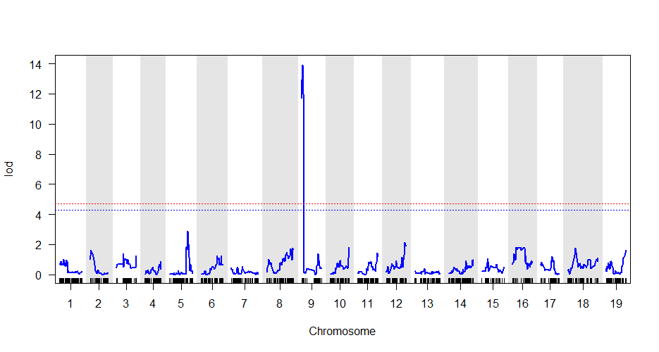
What is QTL mapping?
A genome-wide test to identify regions of the genome that are responsible for a trait of interest (herbicide resistance).
Functions on the assumption that your trait is heritable and caused by some nuclear genetic variant
Inputs: genotypic and phenotypic data from a population segregating for your trait of interest
Output: a list of genomic regions that likely house the genetic element causing your trait of interest
Image: https://avikarn.com/2019-04-23-composite-interval-mapping/

Slide 3
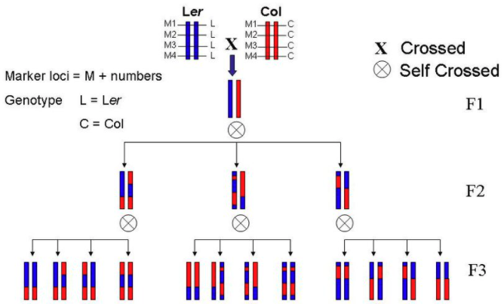
Basic steps of mapping
Identify plants with variation for your trait
resistance surveys, mutagenized populations, screening diversity panels, etc
Sensitive
Resistant
Ishihara 2007

Slide 4
Basic steps of mapping
Identify plants with variation for your trait
resistance surveys, mutagenized populations, screening diversity panels, etc
Create some delimiting assay to separate phenotypes
Delimiting rate, leaf disk assay, translocation/metabolism experiments, etc
Sensitive
Resistant
Ishihara 2007

Slide 5
Basic steps of mapping
Identify plants with variation for your trait
resistance surveys, mutagenized populations, screening diversity panels, etc
Create some delimiting assay to separate phenotypes
Delimiting rate, leaf disk assay, translocation/metabolism experiments, etc
Generate segregating population(s)
F2, backcross, recombinant inbred lines, etc
Sensitive
Resistant
Ishihara 2007

Slide 6
Basic steps of mapping
Identify plants with variation for your trait
resistance surveys, mutagenized populations, screening diversity panels, etc
Create some delimiting assay to separate phenotypes
Delimiting rate, leaf disk assay, translocation/metabolism experiments, etc
Generate segregating population(s)
F2, backcross, recombinant inbred lines, etc
Collect DNA and phenotypes from individuals of said population(s)
Sensitive
Resistant
Ishihara 2007
A
D
A

Slide 7
Basic steps of mapping
Identify plants with variation for your trait
resistance surveys, mutagenized populations, screening diversity panels, etc
Create some delimiting assay to separate phenotypes
Delimiting rate, leaf disk assay, translocation/metabolism experiments, etc
Generate segregating population(s)
F2, backcross, recombinant inbred lines, etc
Collect DNA and phenotypes from individuals of said population(s)
Sequence the collected DNA
RAD-seq, exome capture sequencing, shotgun sequencing, RNA sequencing
Sensitive
Resistant
Ishihara 2007
A
D
A

Slide 8
Basic steps of mapping
Identify plants with variation for your trait
resistance surveys, mutagenized populations, screening diversity panels, etc
Create some delimiting assay to separate phenotypes
Delimiting rate, leaf disk assay, translocation/metabolism experiments, etc
Generate segregating population(s)
F2, backcross, recombinant inbred lines, etc
Collect DNA and phenotypes from individuals of said population(s)
Sequence the collected DNA
RAD-seq, exome capture sequencing, shotgun sequencing, RNA sequencing
Use the following bioinformatic pipeline to identify QTL underlying your trait
Sensitive
Resistant
Ishihara 2007
Candidate genes
A
D
A

Slide 9
Basic steps of mapping
Identify plants with variation for your trait
resistance surveys, mutagenized populations, screening diversity panels, etc
Create some delimiting assay to separate phenotypes
Delimiting rate, leaf disk assay, translocation/metabolism experiments, etc
Generate segregating population(s)
F2, backcross, recombinant inbred lines, etc
Collect DNA and phenotypes from individuals of said population(s)
Sequence the collected DNA
RAD-seq, exome capture sequencing, shotgun sequencing, RNA sequencing
Use the following bioinformatic pipeline to identify QTL underlying your trait
Validate identified QTL and test candidate genes with functional genomics
Sensitive
Resistant
Ishihara 2007
Candidate genes
A
D
A

Slide 10
Basic steps of mapping
Identify plants with variation for your trait
resistance surveys, mutagenized populations, screening diversity panels, etc
Create some delimiting assay to separate phenotypes
Delimiting rate, leaf disk assay, translocation/metabolism experiments, etc
Generate segregating population(s)
F2, backcross, recombinant inbred lines, etc
Collect DNA and phenotypes from individuals of said population
Sequence the collected DNA
RAD-seq, exome capture sequencing, shotgun sequencing, RNA sequencing
Use the following bioinformatic pipeline to identify QTL underlying your trait
Validate identified QTL and test candidate genes with functional genomics
Sensitive
Resistant
Ishihara 2007
Candidate genes
A
D
A

Slide 11
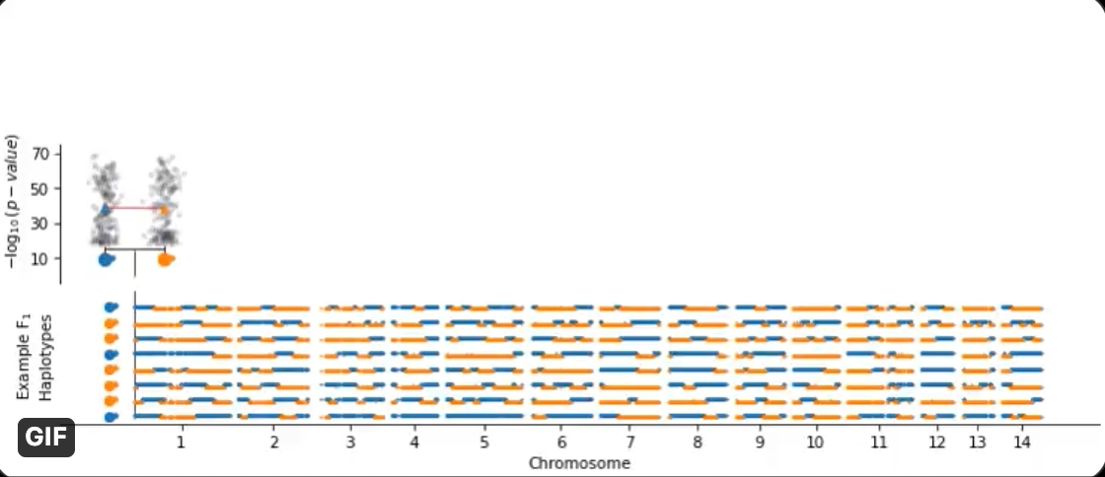
Conceptual visualization of QTL mapping
Image courtesy Collin Roth
https://twitter.com/cullenjnroth/status/1363159662128848899?s=21
F₂

Slide 12
Bioinformatic pipeline
Trim raw reads with Trimmomatic
Demultiplex reads into individual files for each sample
Align reads to reference genome with BWA mem
Call genotype variants with GATK
Use the QTL2 package in R to conduct a genome scan to identify QTL
Use the command line to extract genes in identified QTL
Reference Genome

Slide 13
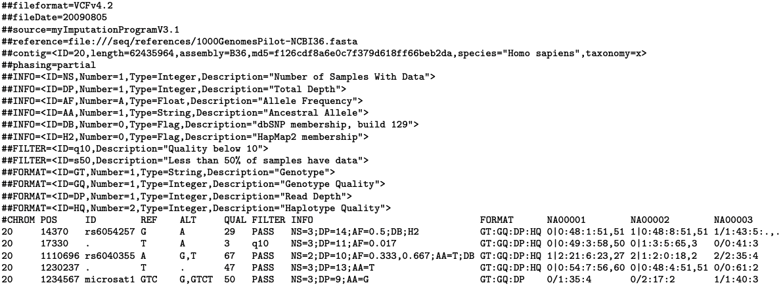
VCF file format
http://samtools.github.io/hts-specs/VCFv4.2.pdf
Header
Samples
Body
Position (bp)
Alternate
Info titles
Chromosome
Reference

Slide 14
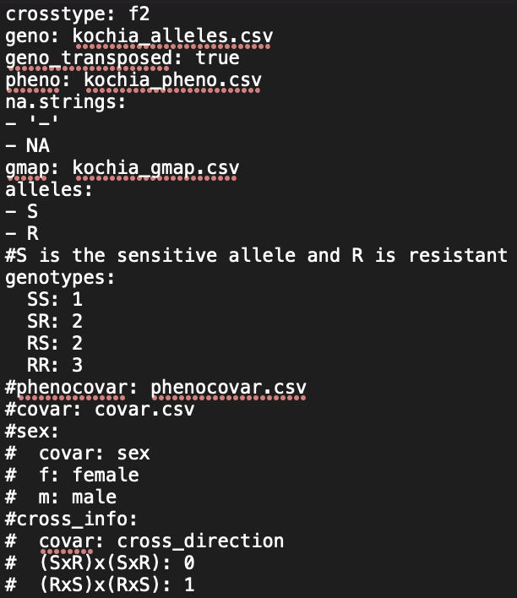
Control file (kochia_qtl_control_file.yaml)
Control file lists all input files used by qtl2
Also specifies important information like:
Cross type
How to specify missing data
What alleles are present
Expected genotypes
Covariate information (not used here)

Slide 15
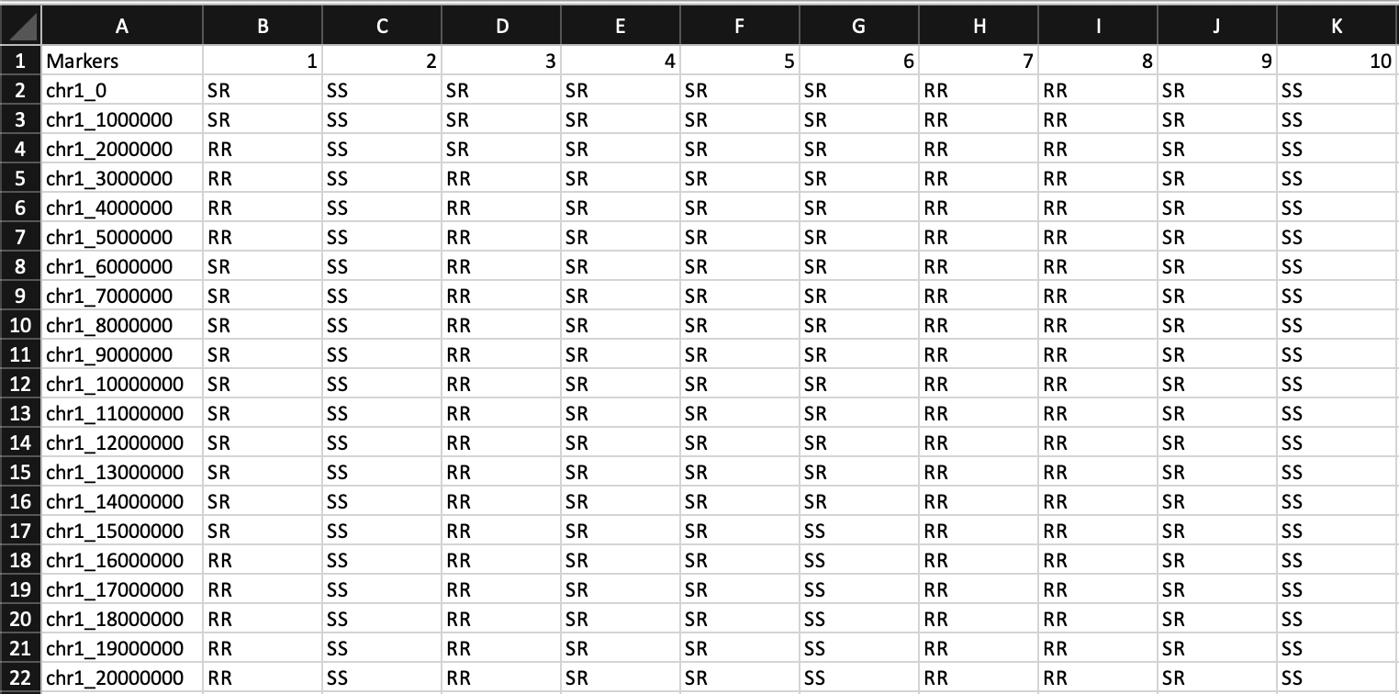
Geno file (kochia_alleles.csv)
Csv file with markers as rows and samples as columns
Alleles should be assigned based on parental donation
If in this format, geno_transposed should be set to true in control file

Slide 16
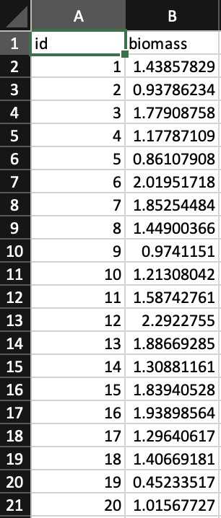
Pheno file (kochia_pheno.csv)
Csv file with sample ID’s in the first column
Information on phenotype(s) in following column(s)
Here, biomass (in grams) 2 weeks following herbicide application is our phenotype of interest

Slide 17
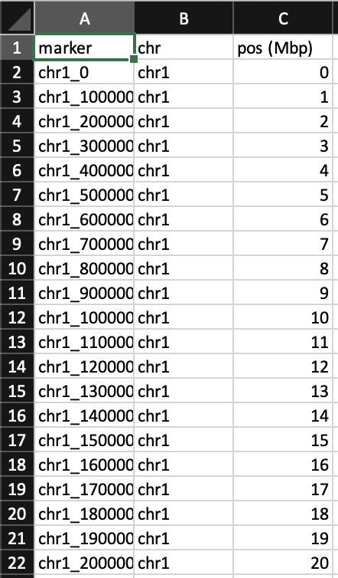
Gmap file (kochia_gmap.csv)
Csv file with marker ID in the first column
Chromosome and position (either in Mbp or cM) in following columns
This file is used to understand physical distance between markers

Slide 18
Move over to R to go through genome scan
Helpful documentation at https://kbroman.org/qtl2

Slide 19
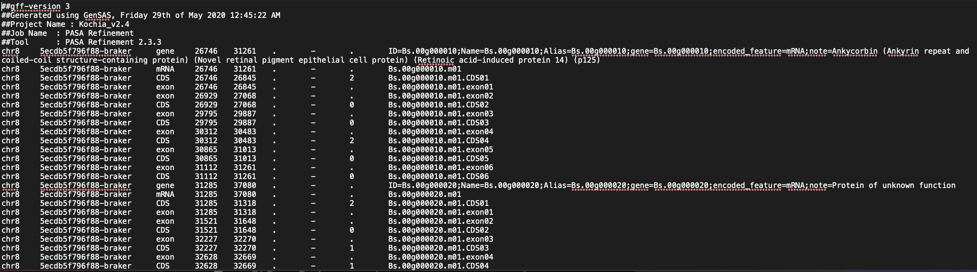
Gff file format for gene annotations
Header
Body
Feature type
End bp
ID fields including annotation
Chromosome
Start bp

Slide 20
Closing points
Accuracy in phenotyping is essential to reduce error in the QTL scan
Using diverse parents yields more polymorphic sites to use as markers
Genetic mapping is best used in conjunction with other data to refine the resulting list of candidate genes
Reliable annotations are essential for candidate gene discovery
Discovered QTL should be either validated on an independent F2 or candidate genes functionally validated
Fine mapping often follows QTL discovery to reduce the number of candidate genes

Slide 21
Important works to cite
Trimmomatic: Bolger AM, Lohse M, Usadel B. 2014. Trimmomatic: a flexible trimmer for Illumina sequence data. Bioinformatics 30: 2114–2120.
BWA MEM: Li H. (2013) Aligning sequence reads, clone sequences and assembly contigs with BWA-MEM. arXiv:1303.3997v1
GATK: Van der Auwera GA & O'Connor BD. (2020). Genomics in the Cloud: Using Docker, GATK, and WDL in Terra (1st Edition). O'Reilly Media.
Qtl2 package: Broman KW, Gatti DM, Simecek P, Furlotte NA, Prins P, Sen Ś, Yandell BS, Churchill GA (2018) R/qtl2: software for mapping quantitative trait loci with high-dimensional data and multi-parent populations. Genetics 211:495-502
My custom scripts: https://github.com/JMont12/qtl_mapping_tutorial

